Slide 1


Complex cinder cone eruptive sequence at O’Neill Crater, San Francisco Volcanic Field
Beth Schreck
Northern Arizona University
Mentor: Dr. Nancy Riggs

Slide 2
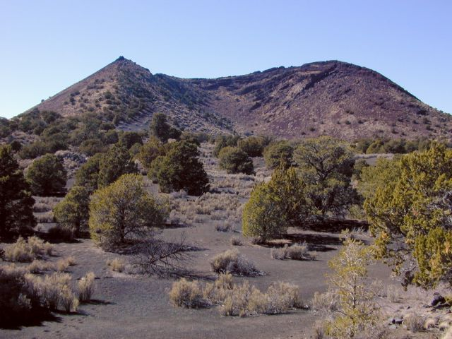
Introduction
The San Francisco Volcanic Field - 4,700 km², over 600 volcanoes, 6 Ma to present
Basaltic volcanism characteristics
Changes in vent activity
Lava breaching and rafting
Post-rafting activity
http://facweb.bhc.edu/academics/science/harwoodr/rhweb/thesis/index.htm
Notes:
The SFVF covers an area in northern arizona of 4,700 km² has been active for over 6 million years, with formation of over 600 volcanoes, dominantly cinder cones
Basaltic volcanism is characterized by low silica content, low-viscosity and formation of cinder cones
Activity in the vent changes with different phases of eruption directly related to the ratio of gas/liquid in the magma
When lava erupts after cone-building is complete the lava can breach the a cinder cone, and large segments of the cone can be removed and rafted on the surface of the flow creating an asymmetrical morphology exemplified in the photo of strawberry crater-point to photo
Typically post-rafting activity occurs that facilitates rebuilding of the cone to its symmetrical shape
Occasionally changes in eruptive regime prevent cone re-growth

Slide 3
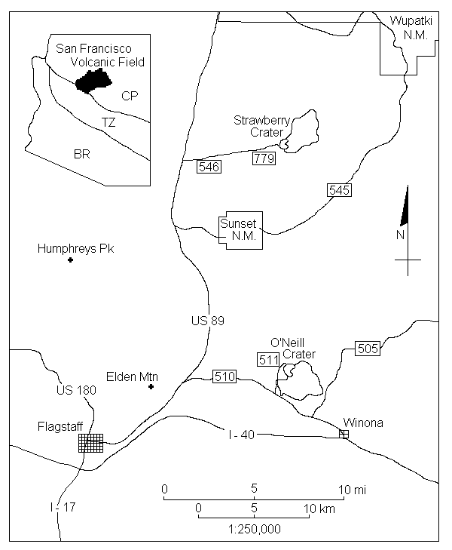
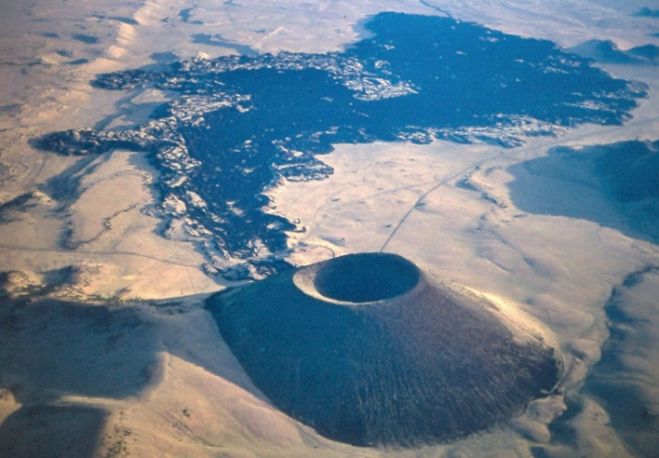
Project Goals
O’Neill Crater
Why was there no cone re-growth with further eruption?
Cinder cone models currently too simplistic
Cinder cones on Mars may have complex morphology
http://facweb.bhc.edu/
academics/science/
harwoodr/rhweb/thesis/
FullThesis/index.htm
SP Crater photo courtesy WA Duffield
Notes:
O’Neill Crater, in the San Francisco Volcanic Field is my field area-point out on map, breaching of the cone occurred followed by further eruptive phases that did not rebuild the cone
The question I have been trying to answer is why was cone re-growth not possible at O’Neill Crater even though subsequent eruptive phases occurred like at SP crater in the San Francisco Volcanic Field?-point to photo. Sp Crater also experienced breaching and rafting but re-built with continued eruption
Why is this study important?
The current models for eruption and growth of cinder cones is too simplistic
Little attention has been paid to the complexities sometimes seen in basalt volcanism and the formation and eruptive histories of cinder cones
Cinder cones on Mars may not reflect the perfect symmetry we so often think of, like SP

Slide 4
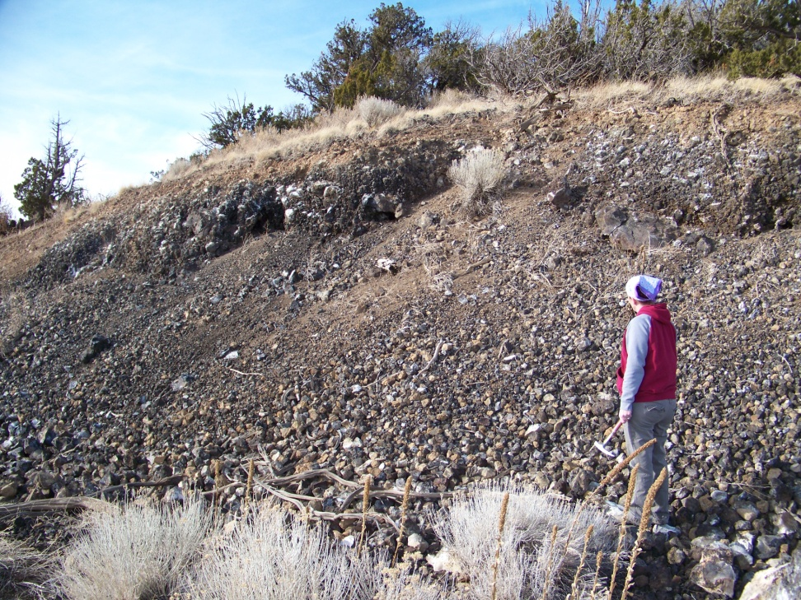
Data
Data collection at O’Neill Crater
Field work
Samples collected for thin section and Optically Stimulated Luminescence dating
Notes:
Data collection consists of field work by mapping, geologic analysis of the area using some necessary tools such as a brunton compass
Samples were strategically gathered from the area to have thin sections made for microscope work
And, in addition to determining the chronology of the area, a more constrained age for O’Neill will be obtained using the relatively new technique, Optically stimulated luminescence
The last determination of the age of formation for O’Neill Crater was completed in the 70’s using K/Ar
It was determined at that time that the age of formation was 50,000 years old +-14,000 years
OSL analysis should yield a more accurate and constrained time frame for formation

Slide 5
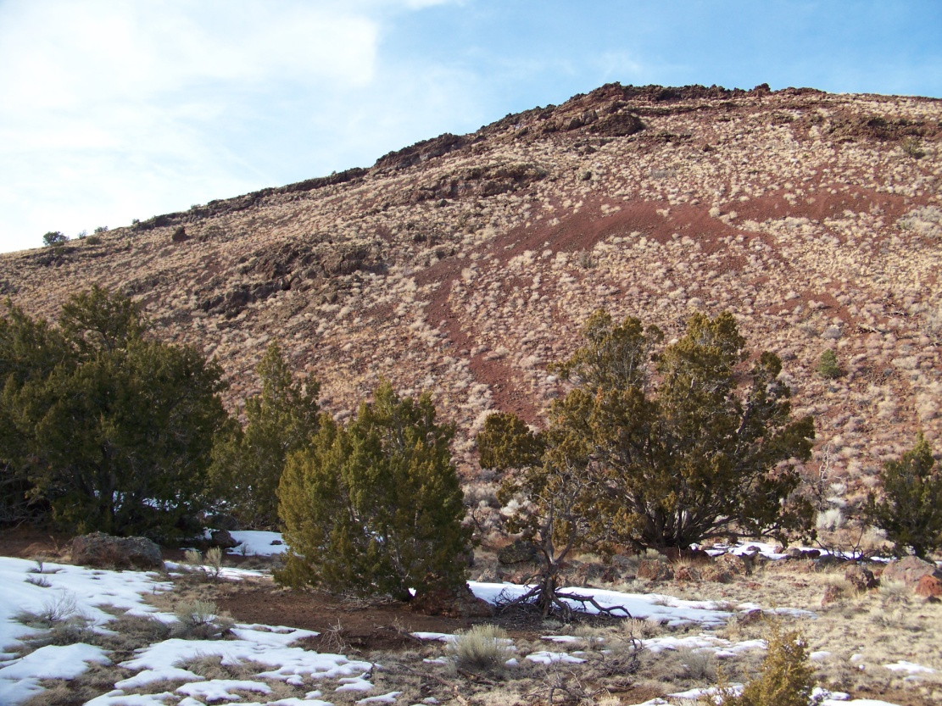
Analysis
Thin sections
Rock crushing and lab work
Mapping
Geologic principles
Notes:
Thin section analysis is still ongoing as is rock crushing for OSL dating that will be completed this summer at the Utah State University OSL lab
Further mapping is also necessary to determine complex relations in some outcrops found in the field area
Using geologic principles such as the Law of Superposition, cross-cutting relations, and a knowledge of volcanology, a chronology of events can be determined

Slide 6
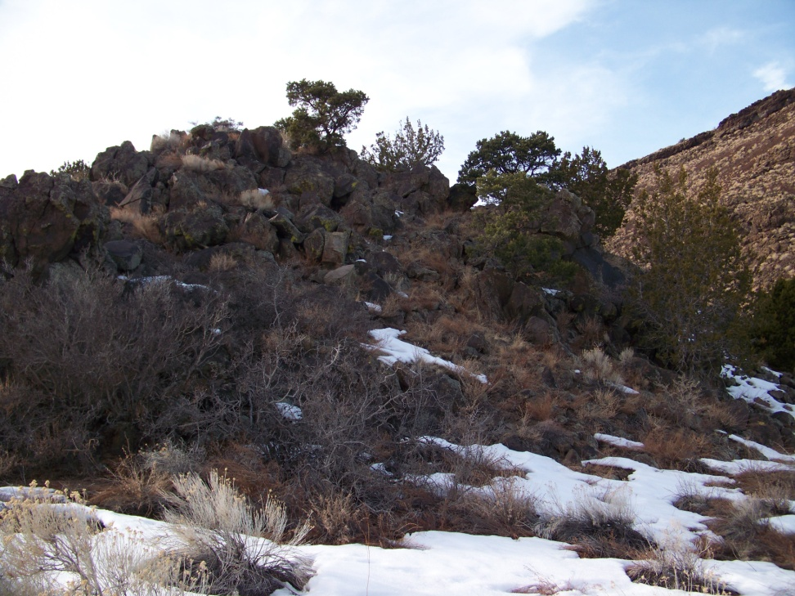
Results
Goal: eruptive history of O’Neill crater
Chronology based on field analysis:
Cone-building stage
Continued eruption breached cone
Extrusion of dacite dome
Notes:
My goal in this project was to determine the eruptive history to explain the complex morphology at O’Neill crater
The chronology can be described as follows:
First, a vent opened up and eruption created the cone
Second, once the cone-building stage was complete, continued eruption weakened the cone on the eastern side creating a breach where lava escaped and rafted large portions of the cone away on the surface of the flow
Third, extrusion of the more viscous dacite dome occurred (Point out photo)

Slide 7
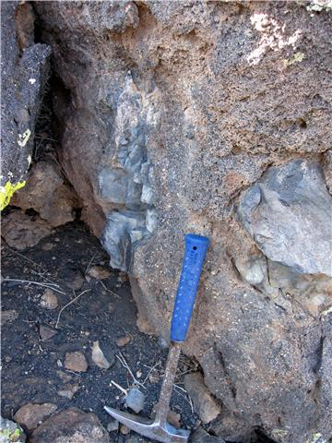
Results
Dacite dome extrusion complex
Injection of basaltic- andesite
Eruption triggered
dacite
basaltic-
andesite
Notes:
After the cone breaching stage, likely the magma left behind in the conduit consisted of the dacite that now makes up the dome
An injection of new basaltic-andesite magma into the conduit caused an increase in pressure that triggered a new eruption in which the dacite dome was extruded-inclusions of basaltic-andesite in the dacite dome can be found as seen in the photo

Slide 8
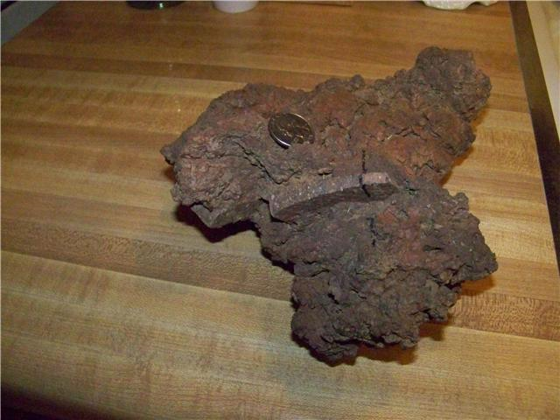
Results
Basaltic-andesite eruption continues
Evidence from rocks collected
Question still needs to be answered
New thin section made
dacite fragment
basaltic-
andesite
Notes:
After the dacite erupted, basaltic-andesite continued to erupt using the same conduit
Rocks collected in the field have rigid pieces of the dacite surrounded by basaltic andesite cinder as seen in the photo which is evidence of the eruption that followed
The lack of significant outcrops of this late stage basaltic andesite eruption suggests that the volume erupted was insufficient to re-build the cone where the breach occurred
The question we have now is how long was the lag time between the eruption of the dacite and the eruption of the basaltic-andesite?
A new thin section is being made to view the contact between the dacite and basaltic andesite to look for evidence of a chilled margin on the dacite which should answer this new question

Slide 9
Acknowledgments
Dr. Nancy Riggs
NAU Space Grant Program
My family
Notes:
I would like to thank Dr. Nancy Riggs for giving me this amazing opportunity and being such a wonderful mentor
I would like to thank the NAU Space Grant Office for their support of undergraduates completing research
And my family, without them, this would not have been possible for me

Slide 10
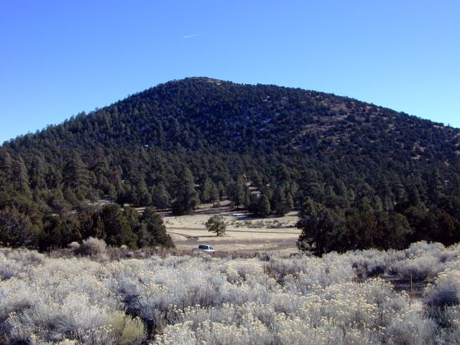
Questions?
http://facweb.bhc.edu/academics/science/harwoodr/rhweb/thesis/index.htm

